Slide 1
THERMAL INTEGRATION IN REACTIVE BATCH DISTILLATION: TECHNO-ECONOMIC ANALYSIS
MINOR RESEARCH PROJECT
END REVIEW
Presented by
Lingala Rashmitha(206128)
Gellileo Mittakola(206233)
D Sai Sathvik Reddy(206112)
R Govind(206243)
Under the Guidance of
Dr. G Uday Bhaskar Babu (Associate Professor)
DEPARTMENT OF CHEMICAL ENGINEERING
NATIONAL INSTITUTE OF TECHNOLOGY WARANGAL
TELANGANA - 506004

Slide 2
PRESENTATION OUTLINE
Introduction and Literature Review
Objectives
Conventional Reactive Batch Distillation (CRBD) for production of Butyl Acetate
Vapor Recompression in Reactive Batch Distillation (VRCRBD) for production of Butyl Acetate
Bottom flashing in Reactive Batch Distillation (BFRBD) for production of Butyl Acetate
Simulation Results and Discussions
Conclusions
Future Work
References

Slide 3
Introduction: Distillation
Distillation
Batch
Continuous
Reactive
Non-Reactive
Steady State Process
Advantages:
Simultaneous reaction and separation of components.
Flexible, allows to deal with uncertainties in feed stock or product specification.
Very high purity of product
Low capital cost and Maintenance cost

Slide 4
Introduction: Why Thermal Integration?
◘Today fossil fuels take up 80% of the primary energy consumed in the world [1]
◘ In the US, the use of fossil fuel leads to produce more than 80% of the total greenhouse gas emissions [2]
Negative effects [1]
◘ Climate change
◘ Receding of glaciers
◘ Rise in sea level
◘ Loss of biodiversity
◘ Progressive depletion of conventional fossil fuels
◘ Increasing energy consumption
◘ Greenhouse gas (GHG) emissions
Need to improve energy efficiency

Slide 5
Introduction: Thermal Integration in Distillation
◘ Distillation is used for about 95% of all fluid separation in the chemical industries [3]
◘ It accounts for an estimated [3]
▪ 3% of the world energy consumption
▪ 10% of total industrial energy consumption in the US
◘ Maximum thermodynamic efficiency of the conventional distillation is around 20% [4]
Distillation is a potential candidate for Thermal Integration

Slide 6
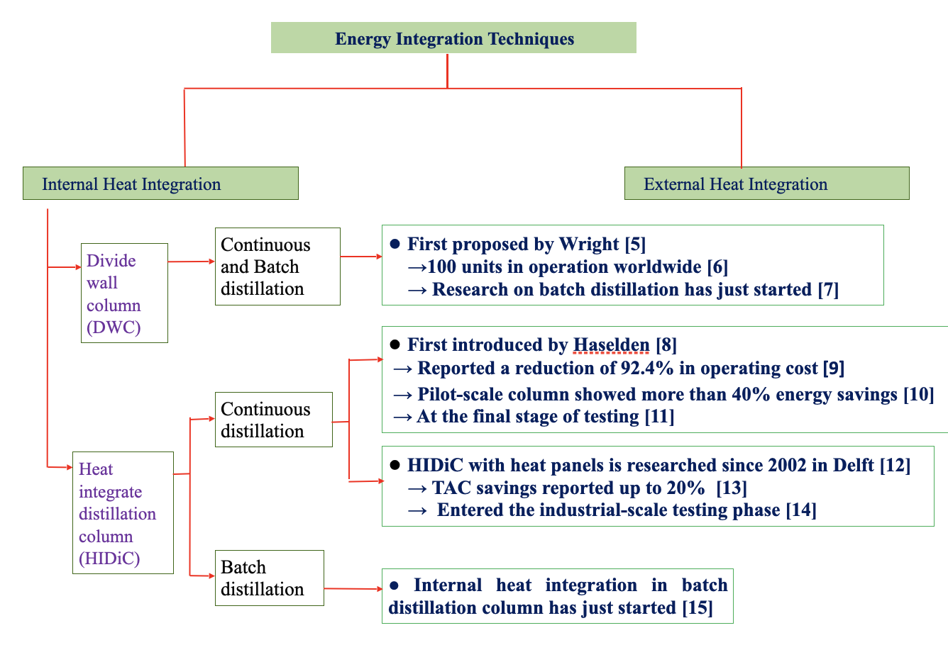
Literature Review

Slide 7
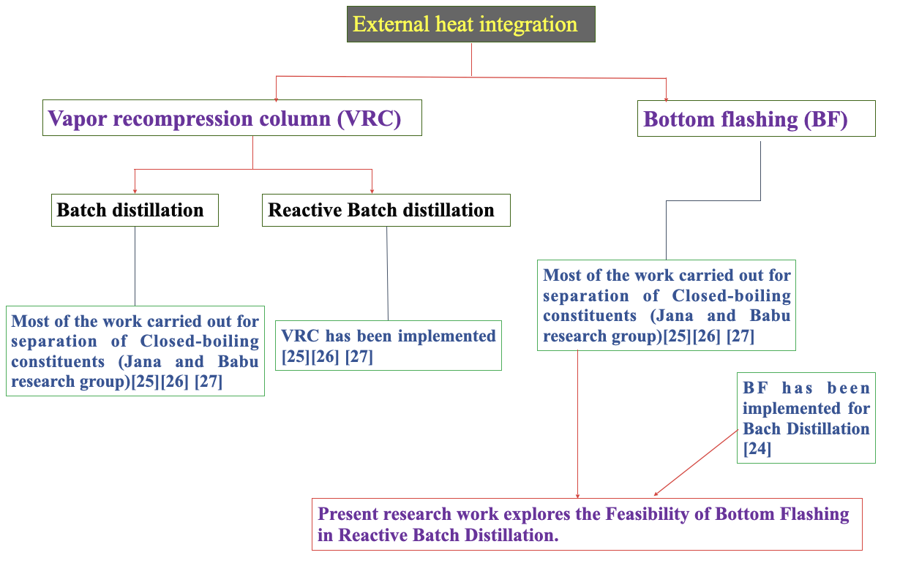
Literature Review

Slide 8
Objectives
Modelling and Simulation of Conventional Reactive Batch Distillation for production of Butyl Acetate.
To Implement Bottom Flashing and Vapor Recompression Techniques in Conventional Reactive Batch Distillation for production of Butyl Acetate to improve Energy Savings and reduce the Total Annual Cost.

Slide 9
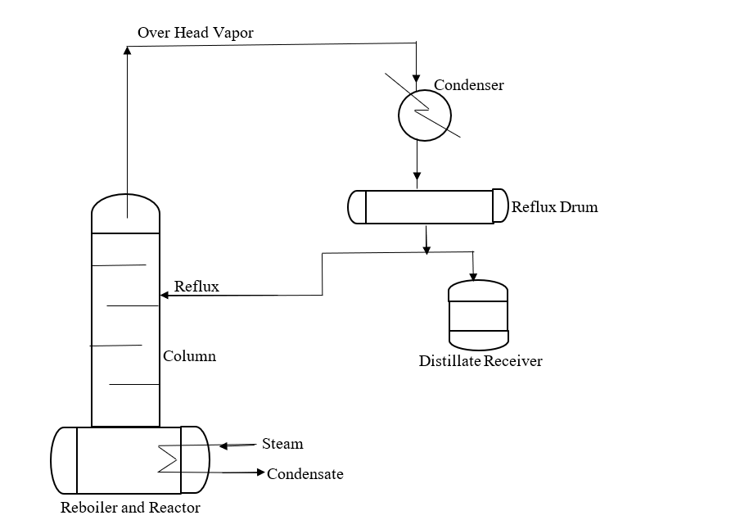
Conventional Reactive Batch Distillation
Process Description
CRBD operates in two modes: start up phase and production phase.
•Start-up phase: The system attains a steady state where the purity of lighter component reaches to maximum purity (D=0).
•Once the system attains a steady-state thereafter immediately production phase starts.
•Production phase: Sequential operation in which the product is withdrawn at a fixed rate.
Fig 1. Conventional Reactive Batch Distillation

Slide 10
Assumptions
Fundamental model for Reactive batch distillation is [3] derived based on assumptions:
•Negligible tray vapor holdups
•Variable liquid holdup in each tray
•Perfect mixing and equilibrium on all trays
•Constant operating pressure (atmospheric)
•Total condensation with no subcooling in the condenser
•Raoult’s law for vapour−liquid equilibrium (VLE)
•Nonlinear Francis Weir formula for liquid hydraulics
•Algebraic form of equations to compute the phase enthalpies
•Fast energy dynamics
•No azeotrope formation [30]
•Constant vapor-phase Murphree efficiency(=75%) [30]

Slide 11
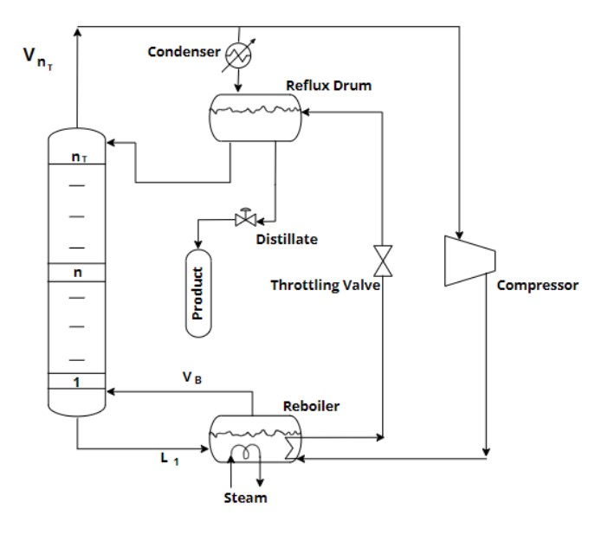
Vapor Recompression in Reactive Batch Distillation:
Process Description
Latent heat of compressed top vapor used for liquid reboiling.
Reduction of CO2 emissions.
Reduction of utility requirements (Thermal).
An additional energy component (compressor) involved in VRCRBD.
Consumption of electricity (much more expensive than thermal utility).
Fig 2. Vapor Recompression in Reactive Batch Distillation

Slide 12
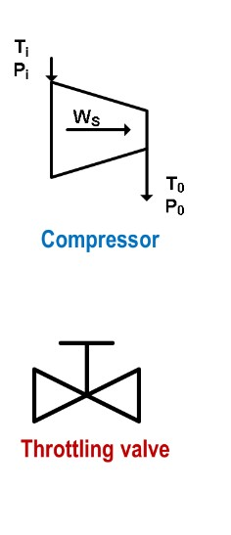
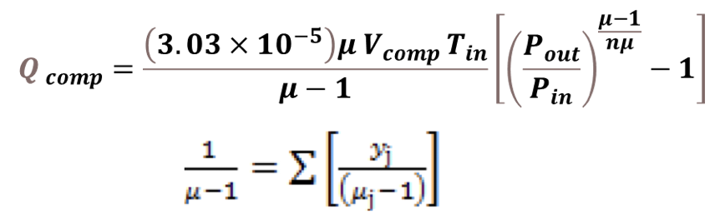
Vapor Recompression in Reactive Batch Distillation
Compressor duty eqn. [ 24]
Compressor energy consumption eqn.
Factor 3 is supposed to convert the compressor work into the thermal energy [23].
Assumptions
Polytropic compressor
No flashing occurred in the valve
Only latent heat released by the compressed vapor in the still is used.
No vaporization in throttling valve.

Slide 13
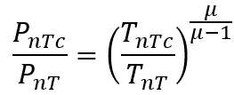

Vapor Recompression in Reactive Batch Distillation:Open-loop control policy
Open Loop Control Policy
Fixed Speed VRCRBD
Variable Speed VRCRBD
Constant Reboiler Heat Duty, QR
Constant,
Scenario-1
When Qcv>QR
Scenario-2
When Qcv<QR
Manipulate CR
Manipulate Top Vapor, VnT
Manipulate Heat Input,QR
QE=QR-QVC
VnTi=VnT-VnTc

Slide 14
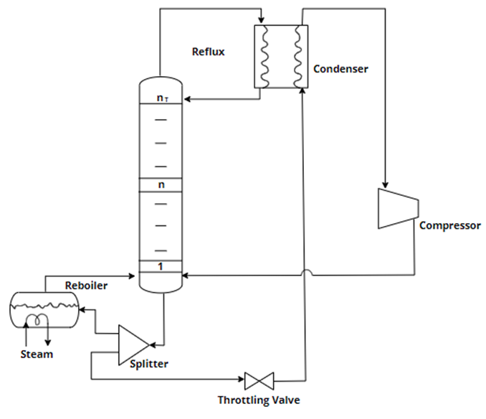
Bottom Flashing in Reactive Batch Distillation:
Process Description
Latent heat of the top vapor is used to vaporize liquid from reboiler.
Reduction of utility requirements(Thermal).
Reduction of CO2 emissions.
An additional energy component (compressor) involved in BFRBD.
Consumption of electricity (much more expensive than thermal utility).
Fig 3. Bottom Flashing in Reactive Batch Distillation

Slide 15
Bottom Flashing in Reactive Batch Distillation
Compressor duty eqn. [ 24]
Compressor energy consumption eqn.
QBFRBD=QE+3Qcomp
Factor 3 is supposed to convert the compressor work into the thermal energy [23].
Assumptions
Polytropic compressor
No flashing occurred in the valve
Only latent heat released by the compressed vapor in the still is used.
No vaporization in throttling valve.

Slide 16
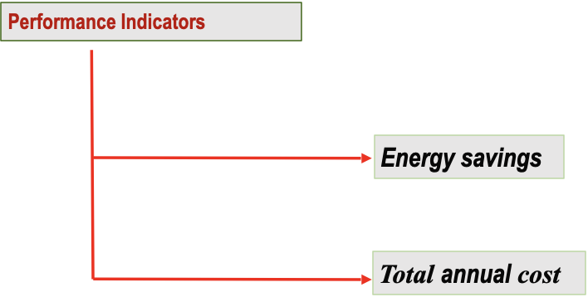
Quantitative Performance Analysis
.

Slide 17
Energy Efficiency
Total heat consumed in operating the thermally integrated column
Q=QE +3Qcomp
For CRBD For VRCRBD For BFRBD
QE=QR=52307.8 QE=0 QE=0 (when Qava>=52307.8)
Qcomp=0 QE=QR-QCV QE=QR-QCV (when Qava<52307.8)
For both startup phase(QSP)as well as production phase(QPP)
QVRCRBD = QSP+QPP
Assumption: 3 kW thermal energy consumed to produce 1 kW of electricity [18]

Slide 18
Total Annual Cost
Cost Estimating formulae: [18]
Column shell: (M&S/280)*101.9*(DC^1.066)*(LC^0.802)*(CIN+(CM*CP)
Column tray: (M&S/280)*4.7*(DC.^1.55)*LC*(CS+CT+CM1)
Where, DC is the column diameter (ft), LC is the column height (ft) and
coefficients CS = 1,CM1 =1.7 and CT =1.8. tray material /type=SS/Bubble cap.
Heat exchanger: (M&S/280)*101.3*(ACO.^0.65)*(CIN+CM(CT+CP))
Utilities Cost: [19]
Steam ($/ton) 17
Cooling water ($/ton) 0.06
Electricity ($/kWh) 0.084
Where, DC is the column diameter (ft), LC is the column height (ft) and the coefficients, CIN =2.18, CM =3.67and CP =1. Shell material =SS.
M&S Index=1704.9
Total annual cost (TAC)= OC + (CI/payback period)
Compressor: (M&S/280)*517.5*(WCOMP2^0.82)*3.11

Slide 19
Simulation Results and Discussion
Table1: Design and Operating Parameters[30]
System | Acetic Acid/Butanol/Butyl Acetate/Water
Total feed charge, Kmol | 200.7
Stages | 16
Tray holdup in each tray (Start-up), Kmol | 0.9
Reflux drum holdup, Kmol | 6
Tray efficiency, % | 75
Heat input to the still pot, KJ/min | 52307.8
Distillate rate(fixed), kmol/min | 0.19066
Composition of feed 0.45/0.45/0.05/0.05

Slide 20
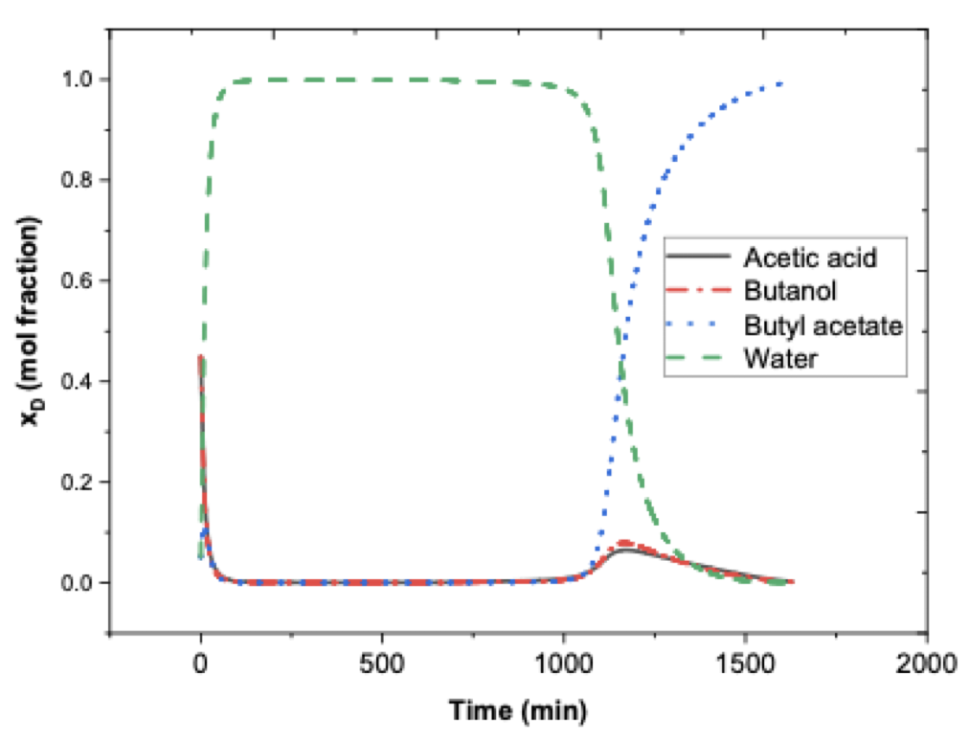
Simulation Results and Discussion
Conventional Reactive Batch Distillation
Fig 4. Distillate composition throughout the batch operation

Slide 21
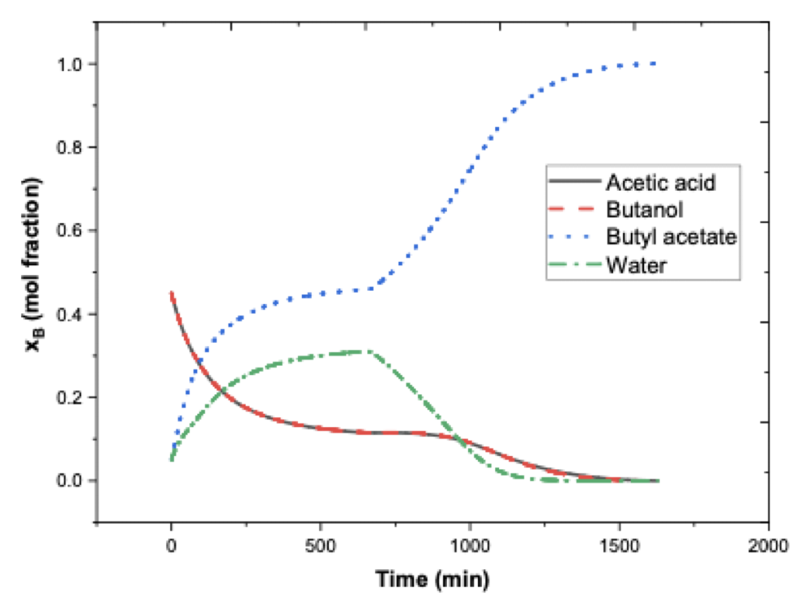
Simulation Results and Discussion
Conventional Reactive Batch Distillation
Fig 5. Reboiler composition throughout the batch operation

Slide 22
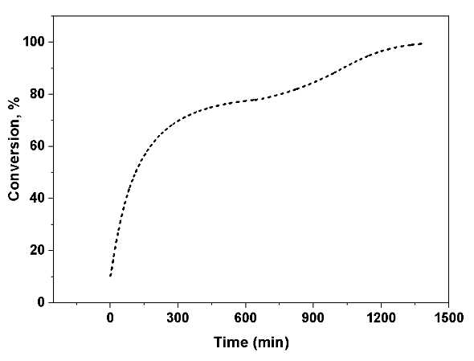
Simulation Results and Discussion
Conventional Reactive Batch Distillation
Fig 6. %Conversion profile throughout the batch operation

Slide 23
Simulation Results and Discussion
Table 2: Operational reactive batch time
System | Acetic Acid/Butanol/Butyl acetate/Water
Start Up Phase Time, min | 653.7
Production Phase Time, min | 733.2
Total Batch Time, min | 1386.9
Table 3: Compositions of Reboiler and distillate: Start Up and Production Phase
Component | Steady State Composition of Reboiler | End Composition of Reboiler | Steady State Composition of Distillate | End Composition of distillate
Acetic Acid | 0.1153 | 0.0113 | 4.84*10^-4 | 0.0320
Butanol | 0.1156 | 0.0085 | 2.3*10^-4 | 0.0282
Butyl Acetate | 0.459 | 0.98 | 4.93*10^-5 | 0.9161
Water | 0.3101 | 2.3335*10^-4 | 0.9992 | 0.0237

Slide 24
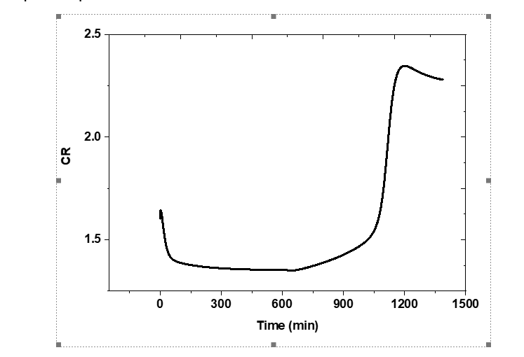
Simulation Results and Discussion
Vapor Recompression in Reactive Batch Distillation
Fig 4. Compression ratio profile throughout the batch operation

Slide 25
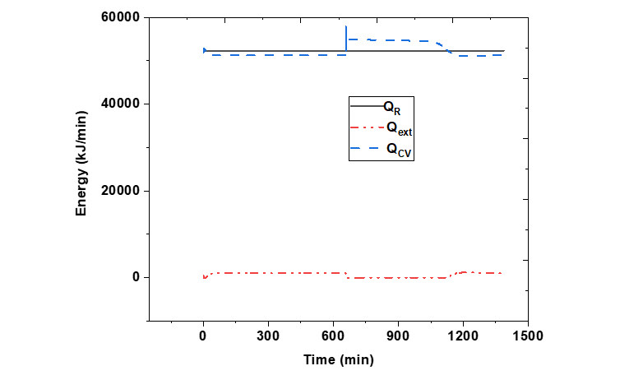
Simulation Results and Discussion
Vapor Recompression in Reactive Batch Distillation
Fig 5. Energy profile throughout the batch operation

Slide 26
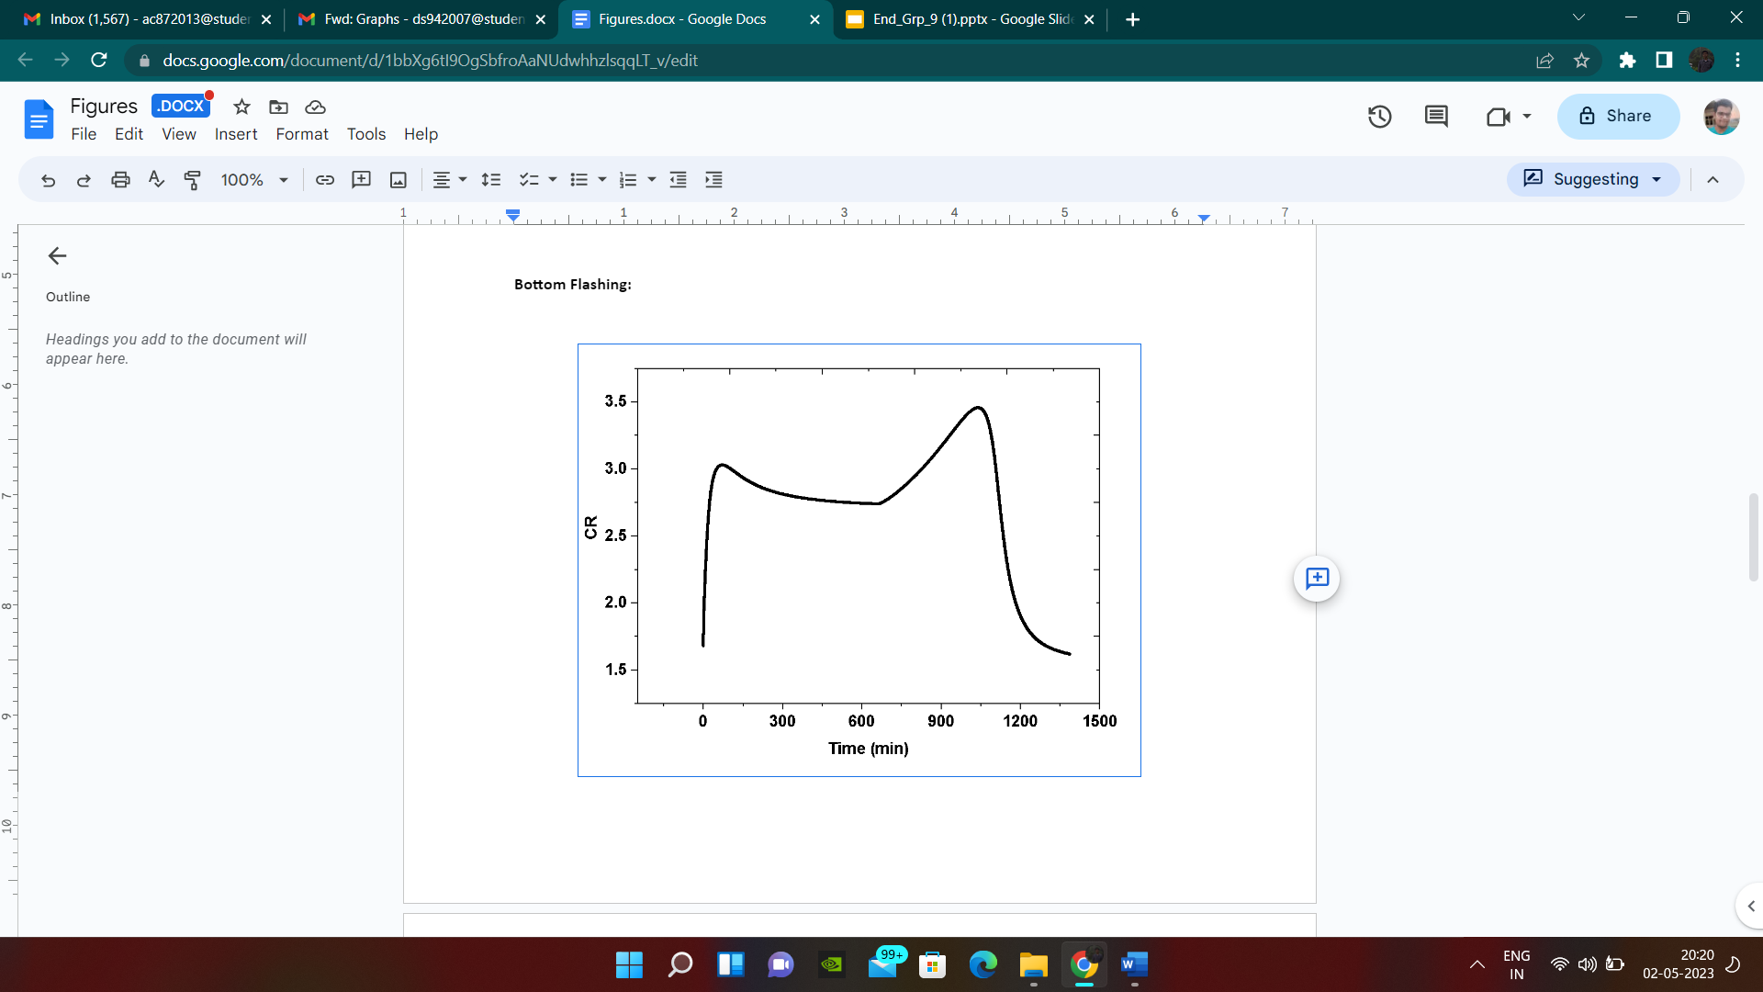
Simulation Results and Discussion
Bottom Flashing in Reactive Batch Distillation
Figure 7. Compression ratio profile throughout the batch operation

Slide 27
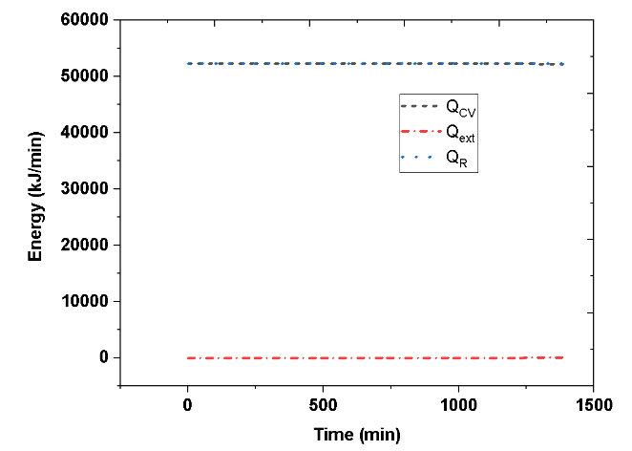
Simulation Results and Discussion
Bottom Flashing in Reactive Batch Distillation
Figure 8. Energy profile throughout the batch operation

Slide 28
Simulation Results and Discussion
Table 4: Economic comparison : Conventional vs Bottom Flashing
Component | CRBD | BFRBD
Capital Cost ($)
Column Shell | 117350 | 117350
Column Tray | 11345 | 11345
Compressor | 0 | 492460
Condenser | 76215 | 74910
Reboiler | 348680 | 1090.9
Total Capital Cost | 553590 | 697155.9
Operational Cost ($)
Cooling water | 18540 | 0
Steam | 193380 | 27.1095
Electricity | 0 | 58905
Total Operational Cost | 211920 | 58932.1
TAC/ 3 years | 396440 | 291320
TAC savings% |  | 26.515

Slide 29
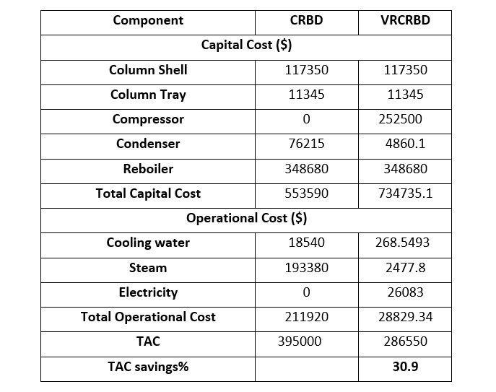
Simulation Results and Discussion
Table 5: Economic comparison : Conventional vs Vapor Recompression

Slide 30
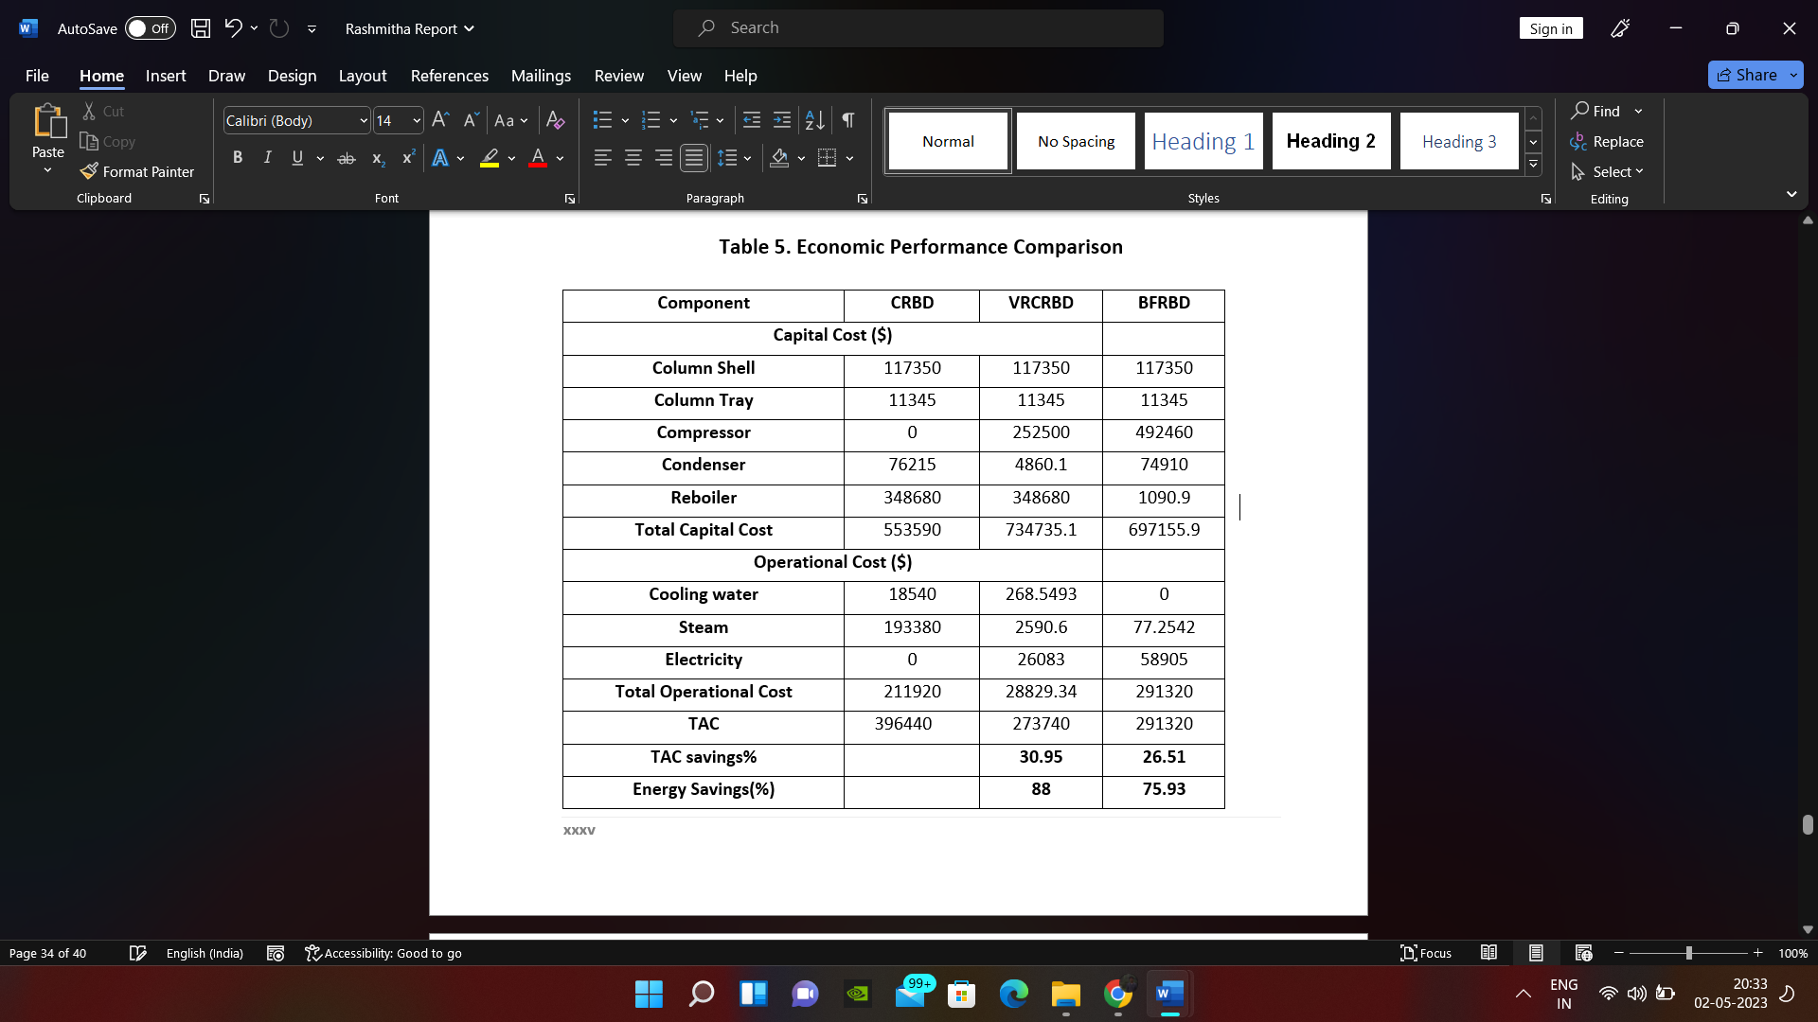
Simulation Results and Discussion
Table 6: Economic comparison : Conventional vs Vapor Recompression vs Bottom Flashing

Slide 31
Conclusions
After carrying out systematic design, operation and simulation approach for Conventional, Vapor Recompression, Bottom Flashing on Reactive Batch Distillation for production of butyl acetate the following can be concluded.
Start Up phase time for the production Butyl Acetate is 653.7 min and total batch time is 1386.9min.
Implementing Vapor Recompression to Conventional Reactive Batch Distillation gives us energy saving around 88%.
Vapor Recompression has a total annual saving of 30.95% for payback period of 3 years.
Implementing Bottom flashing to conventional batch distillation gives us energy saving around 75.93%.
Bottom flashing has a total annual saving of 26.51% for payback period of 3 years.
In comparison between VRBD and BFBD we can conclude that Vapor Recompression gives us better energy saving, about 12% more than BF and also total annual savings in VRC is 4.44% higher than Bottom Flashing.

Slide 32
Future Work
Constant composition control of Reactive Batch Distillation.
Implementation of Bottom Flashing to different reactive systems in Reactive Batch Distillation.
Implementation of bottom flashing in Reactive Batch Distillation for unconventional Reactive Batch Distillation columns: Reactive Batch distillation with a side withdrawal, middle vessel reactive batch distillation, and extractive reactive batch distillation.
Publication
Rashmitha L, Gallilu M, Sathvik D, Govind R, Uday Bhaskar Babu G., Economic feasibility of bottom flashing in reactive batch distillation for production of butyl acetate (Under Preparation)

Slide 33
References
[1] Mulio, J.F., Flores A., Modeling, simulation and control of an internally heat integrated pressure-swing distillation process for bioethanol separation, Comput. Chem. Eng. 35 (2011) 1532-1546.
[2] US energy information administration, Emissions of Greenhouse Gases in the United States 2007, DOE/EIA-0573, December 2008 (accessed December 2009).
[3] Salamon, P., Nulton, J.D., The geometry of separation processes: a horse–carrot theorem for steady flow systems, Europhys. Lett. 42 (1998) 571–576.
[4] De Koeijer, G., Kjelstrup, S., Minimizing entropy production rate in binary tray distillation, Int. J. Appl. Thermodyn. 3 (2000) 105–110.
[5] Wright RO. Fractionation apparatus. US Patent No 2471134.
[6] Kiss A and Rewagad. Energy efficient of a BTX dividing wall column. Comput Chem Engg. 2011; 35:2896-2904.
[7] Girish SJ. Dynamic modeling and optimization of thermally coupled dividing wall column batch distillation process. AICHE Proceedings. 2007;paper211a.
[8] Haselden GG. An approach to minimum power consumption in low temperature gas separation. Trans Inst Chem Eng. 1958;36:123-132.
[9] Chen H, Huang K, Wang S. A novel simplified configuration for an ideal heat-integrated distillation column (ideal HIDiC). Sep Purf Technol. 2010;73:230-242.
[10] Naito K, Nakaiwa M, Huang K, Endo A, Aso K, Nakanishi T, Nakamura T, Noda H, Takamatsu T. Operation of a bench-scale ideal heat integrated distillation column (HIDiC): an experimental study.Comput Chem Eng. 2000;24:495-499.

Slide 34
References
[11] Suphanit B. Design of internally heat-integrated distillation column (HIDiC): Uniform heat transfer area versus uniform heat distribution. Energy. 2010;35:1505-1514.
[12] De Graauw, J., de Rijke, A., Olujic, Z., Jansens, P.J., Distillation column with heat integration, European patent EP1332781, August 2003.
[13] Olujić Z, Sun L, Rijke AD, Jansens PJ. Conceptual design of internally heat integrated propylene-propane splitter. Energy. 2006;31:3083-3096.
[14] Maiti D, Jana AK, Samantha AN. A novel heat integrated batch distillation scheme. Appl Energy 2011;88:5221-5225.
[15] Freshwater DC. The heat pump in multi component distillation. Trans Inst Chem Eng. 1961;6:388-391
[16] Canales ER, Marquez F. Operation and experimental results on a vapor recompression pilot-plant distillation column. Ind Eng Chem Res. 1992;31:2547–2555.
[17] Kathel P, Jana AK. Dynamic simulation and nonlinear control of a rigorous batch reactive distillation. ISA Transactions. 2010;49:130-137.
[18] Douglas JM. Conceptual Design of Chemical Processes. McGraw-Hill, New York, 1988.
[19] Iwakabe K, Nakaiwa M, Huang K, Nakanishi T, Rφsjorde A, Ohmori T, Endo A, Yamamoto T. Energy saving in multi component separation using an internally heat-integrated distillation column (HIDiC). Appl Therm Eng. 2006;26:1362-1368.
[20] Demicoli, D., Stichlmair, J., Separation of ternary mixtures in a batch distillation column with side withdrawal, Comput. Chem. Eng. 28 (2004) 643-650.
[21] Gadalla MA, Olujic Z, Jansens PJ, Jobson M, and Smith R. Reducing CO2 emissions and energy consumption of heat-integrated distillation systems. Environ Sci Technol. 2005;39:6860-6870.
[22] Bequette BW. Process Control: Modeling, Design, and Simulation. 1st ed, Prentice Hall, New- Delhi,2003
[23] Monroy-Loperena R, Alvarez-Ramirez J. Output-Feedback control of reactive batch distillation columns. Ind Eng Chem Res. 2000;39:378-386.

Slide 35
References
[24] Amiya K. Jana Dynamic. simulation, numerical control and analysis of a novel bottom flashing
[25] Amiya K. Jana Dynamic. Bottom flashing with inter reboiling action in a transient batch rectifier,Economic feasibility, dynamics and control. Separation and Purification Technology.179(2017) 320-327.
[26] Xinqiang You, Ivonne Rodriguez-Donis, Vincent Gerbaud. Reducing process cost and CO2 emissions for extractive distillation by double-effect heat integration and mechanical heat pump. Applied Energy. 166(2016) ;128-140.
[27] Abolghasem Kazemi, Arjomand Mehrabani-Zeinabad, Masoud Behesht. Evaluation of various heat pump assisted direct, indirect, Petlyuk and side stripper sequences for three-product separations. Chemical Engineering Science.2018;19-35
[28] Khan, M. N., G.Uday Bhaskar Babu, Jana, A. K., Improving energy efficiency and cost- effectiveness of batch distillation for separating wide boiling constituents. I. Vapor recompression column, Industrial & Engineering Chemistry Research 51 (47) (2012) 15413 - 15422 [ACS]
[29] G.Uday Bhaskar Babu, Pal, E. K., Jana, A. K., An adaptive vapor recompression scheme for a ternary batch distillation with a side withdrawal, Industrial & Engineering Chemistry Research 51(13) (2012) 4990-4997[ACS]
[30] Amiya K. Jana, Debadrita Maiti., Assessment of the implementation of vapor recompression technique in batch distillation. Separation and Purification Technology 107(2013) 1-10
[31] Ganesh Venimadhavan, Michael F. Malone, Michael F.Doherty., A novel Distillate Policy for Batch Reactive Distillation with Application to the Production of Butyl Acetate Ind. Eng. Chem. Res. 1999, 38, 714-722
[32] Sven Steinigeweg, Jurgen Gmehling., n-Butyl Acetate Synthesis via Reactive Distillation: Thermodynamic Aspects, Reaction Kinetics, Pilot-Plant Experiments, and Simulation Studies Ind. Eng. Chem. Res. 2002, 41, 5483-5490 5483
[33] A. K. Jana, Chemical Process Modelling and Computer Simulation, second ed., Prentice-Hall, New Delhi, 2011

Slide 36
THANK YOU

